Slide 1
Chapter 16
Death and Dying
Notes:
Add slide notes here

Slide 2
What Is Death? (1 of 3)
Biological death―a complex process
Harvard Medical School (1968)
  Defined biological death as total brain death
  Irreversible loss of functioning in the entire brain
    Higher centers involved in conscious awareness
    Lower centers that control basic life processes

Slide 3
What Is Death? (2 of 3)
To be judged dead:
  Be totally unresponsive to stimuli, including painful ones
  Fail to move for 1 hour and fail to breathe for 3 minutes after being removed from a ventilator
  No reflexes
  No electrical activity in brain

Slide 4
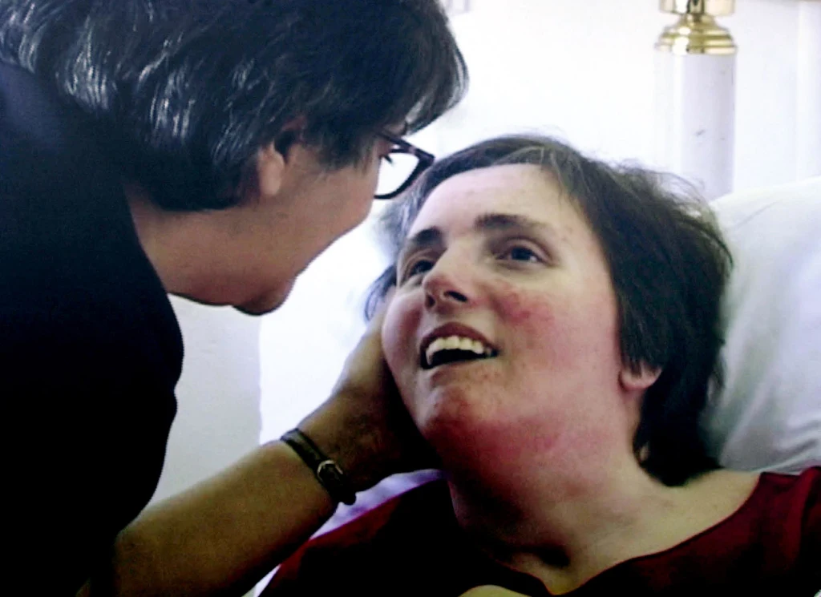
What Is Death? (3 of 3)
Debate about people in comas
  Terry Schiavo case
  Total brain death versus cerebral cortex irreversibly dead
Notes:
Background: Suffered Cardiac arrest on Feb 25th, 1990. Not breathing and had no pulse when paramedics arrived. Resuscitated and put on a ventilator/feeding tube
Persistant vegetative state. Is she alive? (Brain activity slide)
Husband wanted to remove her feeding tube. Terry’s parents objected. No living will. Who has the authority to make the decision?
Lengthy court battle; feeding tube finally removed in 2005 – Fifteen years after the incident

Slide 5
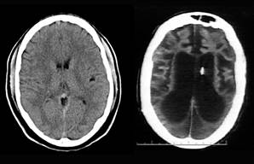
Persistent Vegetative States
Persistent vegetative state (PVS): condition in which a person appears awake but is not aware, due to the permanent loss of all activity in the cortex.
Basic biological functions; no consciousness
Notes:
Background: Suffered Cardiac arrest on Feb 25th, 1990. Not breathing and had no pulse when paramedics arrived. Resuscitated and put on a ventilator/feeding tube
Persistant vegetative state. Is she alive? (Brain activity slide)
Husband wanted to remove her feeding tube. Terry’s parents objected. No living will. Who has the authority to make the decision?
Lengthy court battle; feeding tube finally removed in 2005 – Fifteen years after the incident

Slide 6
Death and End-of-Life Issues (1 of 2)
Euthanasia (“easy death”): controversial practice of assisting terminally ill people of dying more quickly.
  Passive euthanasia: withholding/withdrawing of life-sustaining care.
  Active euthanasia: deliberately-induced death.
Notes:
LO 16-2: Examine definitions of death and end of life considerations.
D. Euthanasia
a. Euthanasia (“easy death”): Controversial practice of assisting terminally ill people of dying more quickly
b. Passive euthanasia—withholding/withdrawing of life-sustaining care
c. Active euthanasia—deliberately-induced death
d. more than two-thirds of adults and 95% of physicians in the U.S. support passive euthanasia
E. Physician-Assisted Suicide
a. Physician-assisted suicide: a type of voluntary active euthanasia in which terminally ill patients make the conscious decision that they want their life to end before dying becomes a protracted process; patients receive from physicians the medical tools needed to end their lives and self-administer the medication
b. Legal in Canada, several European countries, and several U.S. states
c. Oregon was the first state to legalize PAS in 1997

Slide 7
Life and Death Choices (1 of 3)
Physician-assisted suicide: voluntary active euthanasia; terminally ill patients make the conscious decision they want their life to end before dying becomes a protracted process.
  Legal in Canada, European countries, and some states.
  Oregon was the first state to legalize PAS in 1997.
Notes:
LO 16-2: Examine definitions of death and end of life considerations.
D. Euthanasia
a. Euthanasia (“easy death”): Controversial practice of assisting terminally ill people of dying more quickly
b. Passive euthanasia—withholding/withdrawing of life-sustaining care
c. Active euthanasia—deliberately-induced death
d. more than two-thirds of adults and 95% of physicians in the U.S. support passive euthanasia
E. Physician-Assisted Suicide
a. Physician-assisted suicide: a type of voluntary active euthanasia in which terminally ill patients make the conscious decision that they want their life to end before dying becomes a protracted process; patients receive from physicians the medical tools needed to end their lives and self-administer the medication
b. Legal in Canada, several European countries, and several U.S. states
c. Oregon was the first state to legalize PAS in 1997

Slide 8
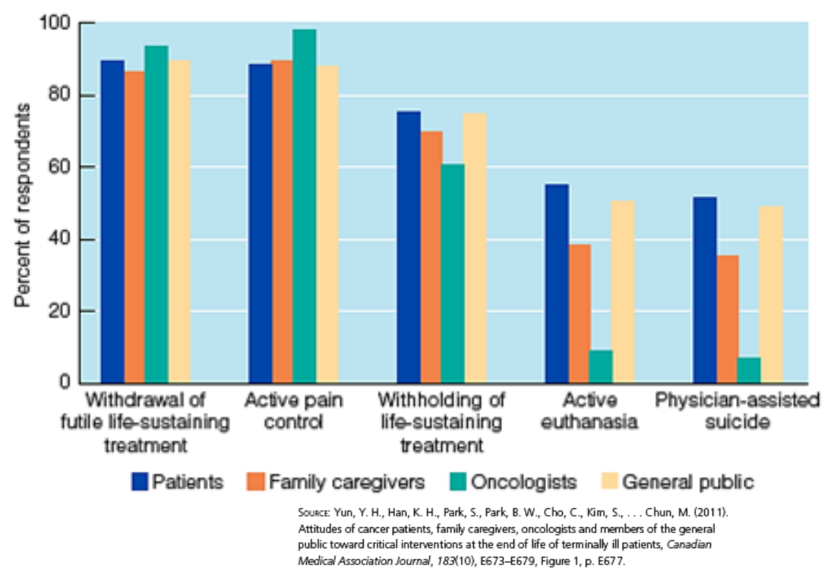
Life and Death Choices (2 of 3)
Notes:
Figure 17.1 Percentages of Korean respondents in four groups expressing support for different end-of-life interventions with terminally ill patients.

Slide 9
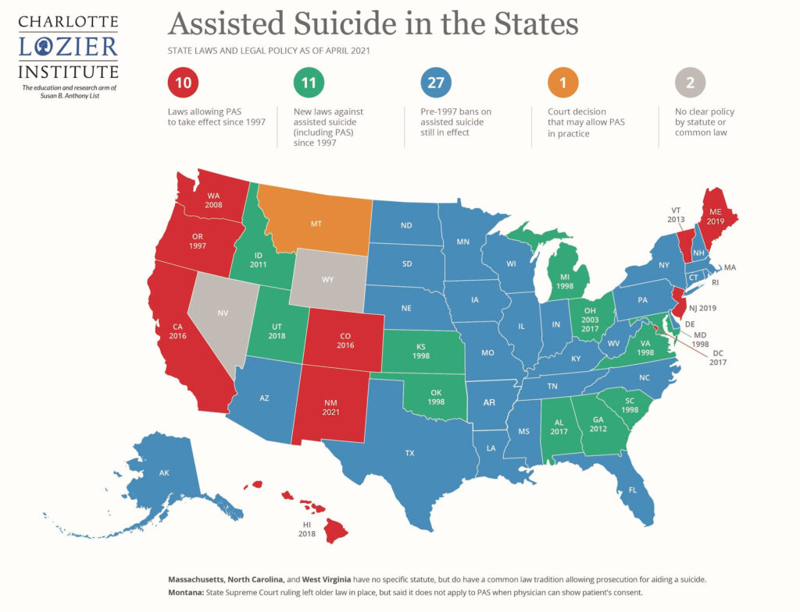
Life and Death Choices (3 of 3)
Notes:
Figure 17.1 Percentages of Korean respondents in four groups expressing support for different end-of-life interventions with terminally ill patients.

Slide 10
Creating a Final Scenario
End-of-life issues: discussing and formalizing management of life’s final phases, after-death disposition of one’s body, and lawful distribution of assets (e.g., through a will)
Final scenario: making one’s choices known and providing information about how one wants one’s life to end, including the process of separating from family and friends

Slide 11
Death and End-of-Life Issues (2 of 2)
Hospice: end-of-life care that emphasizes dying patients’ needs for pain management, psychological, spiritual, and social support, and death with dignity.
Palliative care: rather than treatment, controlling pain and related symptoms of dying persons.
Home hospice care is associated with increased satisfaction by patients and families.
Notes:
LO 16-2: Examine definitions of death and end of life considerations.
F. Hospice
a. Hospice: an approach to end-of-life care that emphasizes dying patients’ needs for pain management, psychological, spiritual, and social support, and death with dignity
b. Philosophy of the hospice approach emphasizing prolonging quality of life rather than prolonging life
c. Most dying people want to die at home with family and friends
d. Palliative care: rather than treatment, controlling pain and related symptoms of dying persons
e. Services enlisted after the physician and patient believe the illness is terminal and that no treatment or cure is possible
f. Services may be inpatient, at a formal hospice site that provides all care to patients, but are frequently outpatient, in a patient’s home
g. Home hospice care is associated with increased satisfaction by patients and families
h. Patient care team includes physicians, nurses, social workers, and counselors who act as spiritual and bereavement counselors

Slide 12
What Kills Us and When? (1 of 3)
The average U.S. citizen born today will live to be about 80.
In 1900, the average lifespan was less than 50.
Advances in medicine and sanitation have extended lifespan by over 30 years.
Notes:
LO 16-1: Identify the leading causes of death and patterns of mortality and life expectancy.
I. Patterns of Mortality and Defining Death
A. The average U.S. citizen born today will live to be about 80; in 1900, the average lifespan was less than 50
B. Advances in medicine and sanitation have extended lifespan by over 30 years

Slide 13
What Kills Us and When? (2 of 3)
In the U.S., mortality has declined by over two thirds between 1935 and 2014.
Fatality in pregnancy and birth for infants and mothers has dramatically decreased.
COVID-19 contributed to a decline in life expectancy.
Notes:
LO 16-1: Identify the leading causes of death and patterns of mortality and life expectancy.
C. Mortality and Life Expectancy
a. In the U.S., mortality across all ages declined by over two thirds between 1935 and 2014
b. Women are less likely to die in childbirth, infants are more likely to survive their first year, children/adolescents are more likely to grow to adulthood, adults are likely to overcome conditions that were once fatal
c. However, the mortality rate for Black infants is more than twice that of Hispanic and non-Hispanic white infants; due to longstanding lack of access and cumulative effects of racism and discrimination
d. Black men also have a lower life expectancy than white and Hispanic men
e. COVID-19 contributed to a decline in life expectancy; people of color were most vulnerable to mortality

Slide 14
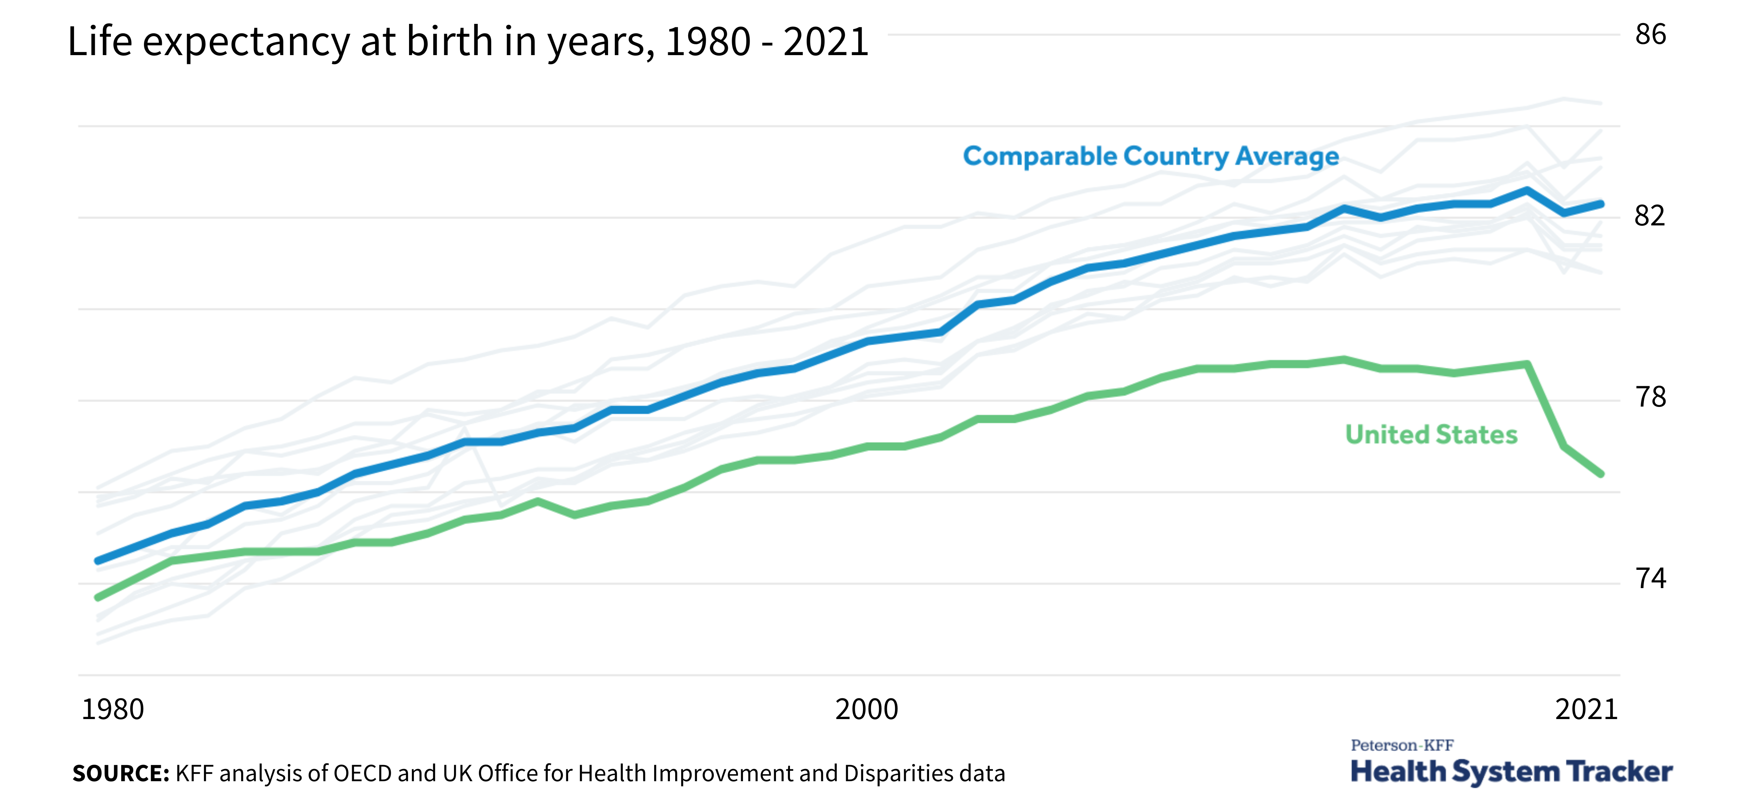
Notes:
vulnerable to mortality

Slide 15
What Kills Us and When? (3 of 3)
Leading cause of death
  Preschool and school children: unintentional injuries (car accidents)
  Adolescence and early adulthood: accidents (especially car accidents), homicides, and suicides
  45–64 age group: cancers
  65 years and older: heart disease

Slide 16
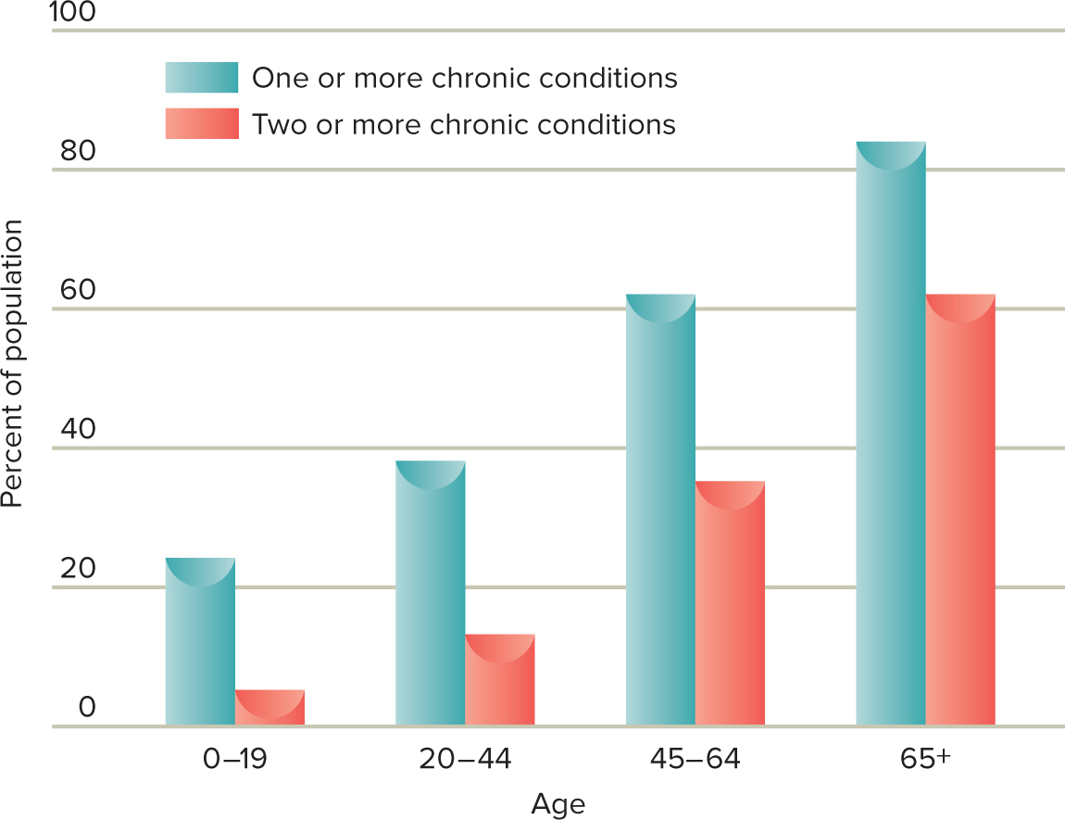
Prevalence of Chronic Conditions Across Age Groups

Slide 17
Social Meanings of Death
Death is also a psychological and social process.
Ariès argues that Western societies:
  Are engaged in denial of death
  Have taken it out of homes and into hospitals/funeral homes
Cultural variations in grieving
  No one right way to grieve

Slide 18
Perspectives on Dying (1 of 5)
Kübler-Ross’s five stages of dying
  Denial
    Defense mechanism; anxiety-provoking thoughts are kept out of conscious awareness
  Anger
    Why me?
  Bargaining
    Bargainer begs for some concession from God, the medical staff, or family members

Slide 19
Perspectives on Dying (2 of 5)
Kübler-Ross’s five stages of dying
  Depression
    Depression, despair, and a sense of hopelessness become the predominant emotional responses
  Acceptance
    Accept the inevitability of death in a calm and peaceful manner

Slide 20
Perspectives on Dying (3 of 5)
Dying children: show a more advanced understanding of death.
Dying adolescents: engage in denial, want to understand their illness and treatment, and show concern for their social relationships.
Dying young adults: react similarly to adolescents.
Dying middle-aged adults: mourn the loss of their lives as they are.
Dying older adults: focus on making peace with the lives they have led.
Notes:
LO 16-4: Discuss the physical and emotional process of dying as it is experienced over the lifespan.
C. The Experience of One’s Death
a. The Dying Child
i. Show a more advanced understanding of death, often greater than that of their older, healthier peers
ii. May have an intuitive sense of dying even before it is medically certain
iii. Important to provide direct answers to questions and companionship/emotional support
b. The Dying Adolescent
i. Many engage in denial due to the personal fable
ii. Determined to understand the nature of their illness and treatment, reflecting growing autonomy
iii. Physical side effects of treatment, particularly ones that have negative effects on appearance, can cause great distress
iv. Show concern for the effects of their illness and treatment on social relationships
v. May struggle with the fact that they are not going to experience having an adult life and future
c. The Dying Adult
i. Young adults often react to dying in a similar way to adolescents
ii. Middle-aged adults are more likely to mourn the loss of their lives as they are and worry about no longer being able to meet their responsibilities and obligations to others
iii. Older adults are more likely to focus on making peace with the lives they have led (e.g., looking back and coming to terms with their lives as a whole)

Slide 21
A Life-Course Approach to Dying
Shift from formal to postformal thinking helps young people integrate emotions/thoughts about death
Parents’ death helps middle-aged adults think about their own death
Older adults are generally less anxious about death and accept it more

Slide 22
Perspectives on Dying (4 of 5)
Criticisms of Kübler-Ross’s five stages of dying
  Emotional responses to dying are not stage-like
  The nature and course of an illness affects reactions to it
  Individuals differ widely in their responses
  Dying people focus on living, not just dying

Slide 23
Perspectives on Dying (5 of 5)
One study (Nissim et al., 2012) found dying patients have the goals of:
  Controlling dying
  Valuing life in the present
  Creating a living legacy

Slide 24
Conceptions of Death Across the Lifespan (1 of 2)
Infants do not grasp death as cessation of life
Infants
  May grasp the concepts of being and nonbeing
  At 6 or 7 months, begin to display separation anxiety

Slide 25
Conceptions of Death Across the Lifespan (2 of 2)
Preschool-age children view death as reversible rather than irreversible
Children ages 5 to 7 understand death is final
Children’s understanding of death is influenced by:
  Cognitive development
  Cultural experiences
  Life experiences

Slide 26
Advanced Understandings of Death
Adolescents typically understand death as the irreversible cessation of biological processes
  Think that psychological functions such as knowing, believing, and feeling continue
  Often acquire a belief in an afterlife
  Recognize death is inevitable but succumb to the personal fable.

Slide 27
First Experiences with Death
Losing a parent or grandparent
  Also reflect themes of adolescence
    Reluctant to express grief
    May engage in delinquent behavior
    Somatic ailments
  Reactions:
    30% experienced significant grief reactions
    More likely to suffer major depression
    Disrupts completion of developmental tasks

Slide 28
Loss of a Partner
Loss of a spouse or partner often precipitates:
  The need to move
  Entering the labor force or change jobs
  Assuming responsibilities that the partner formerly performed
  Parenting singlehandedly
  Coping with less money

Slide 29
Loss of a Child
Seems unexpected, untimely, and unfair
Unable to make sense of a child’s death
Age of the child who dies has little effect on the severity of the grief
Siblings also grieve but may not have support from parents

Slide 30
Loss of a Parent
Normative life transition
Adjusting to the death of a parent is not usually difficult
Can be a turning point in an adult’s life

Slide 31
Loss of a Spouse
Widowhood: status of a person who has lost a spouse through death and has not remarried.
Widowhood effect: increased likelihood for a recently widowed person to die.
  The greatest challenge to adjustment is loneliness, which can be combatted by children or volunteer work.
  Personal characteristics (e.g., self-esteem and self-efficacy) influence resilience and how people transition to widowhood.
Notes:
LO 16-6: Describe patterns of adjustment after bereavement.
VI. Adjusting to the Death of a Loved One
A. Loss of a Spouse
a. Widowhood: the status of a person who has lost a spouse through death and has not remarried
b. 35% of women and 11% of men over 65 are widows
c. Losing a spouse is one of the most difficult stressors—loss of companionship, financial support, and identity status
d. Identity development task posed by the loss of a spouse is to construct a sense of self separate from the spouse
e. Widowhood Effect
i. Widowhood effect: the increased likelihood for a recently widowed person to die
ii. Men have a greater risk of physical and mental health issues and are more likely to remarry
e. Social Support
i. Greatest challenge to adjustment: loneliness
ii. Widowhood can increase network size, even if only temporarily
iii. While positive support from children can buffer depressive symptoms, negative support is associated with anger, depression, and anxiety
iv. Volunteered work can be protective against loneliness
f. Influences on Adaptation
i. Adaptation to widowhood is influenced by a variety of factors (e.g., circumstances surrounding spouse’s death, spouse’s age)
ii. Relief can accompany sorrow if the spouse had been very sick, which can cause widows to feel guilty
iii. Sense of an unfinished life can early widowhood especially difficult
iv. Personal characteristics (e.g., self-esteem and self-efficacy) influence resilience, and therefore, how people transition to widowhood

Slide 32
Grief (1 of 2)
Bereavement: state of loss resulting from the death of a loved one.
Mourning: culturally patterned ritualistic ways of displaying and expressing bereavement, including special clothing, food, prayers, and gatherings.
Grief: emotional response that includes an array of emotions such as hurt, anger, guilt, and confusion.
Notes:
LO 16-5: Summarize typical grief reactions to the loss of loved ones and influences on the grief process.
V. Bereavement and Grief
A. Bereavement: a state of loss resulting from the death of a loved one
B. Grief: emotional response that includes an array of emotions such as hurt, anger, guilt, and confusion
C. Mourning: culturally patterned ritualistic ways of displaying and expressing bereavement, including special clothing, food, prayers, and gatherings

Slide 33
Grief (2 of 2)
Disenfranchised grief
  Grief that is not fully recognized or appreciated by other people and therefore may not receive much sympathy and support
Complicated grief
  Grief that is unusually prolonged or intense and that impairs functioning

Slide 34
Grieving Over Time
Grief tends to peak within the first six months following the death of a loved one.
But remember individual differences!
  People reported feeling the effects of family member’s deaths 50 years after the event

Slide 35
The Grief Work Perspective and Challenges to It (1 of 2)
Grief work perspective
  View that to cope adaptively with death, bereaved people must:
    Confront their loss
    Experience painful emotions and work through those emotions
    Move toward a detachment from the deceased

Slide 36
The Grief Work Perspective and Challenges to It (2 of 2)
Criticisms of grief work model
  Cross-cultural studies reveal many ways to grieve
    Model may be culturally biased
  Little support for assumption that bereaved individuals must confront their loss and experience painful emotions
  No support for view that we must break our bonds

Slide 37
Who Copes and Who Succumbs?
Coping with bereavement influenced by:
  Individual’s personal resources
    Attachment style
    Personality and coping style
  Nature of the loss
    Violent deaths, child deaths—harder to cope with
  Surrounding context of support and stressors
    Social support aids in coping

Slide 38
Bereaved Individuals
Most bereaved individuals do not need psychological intervention to cope
Those at risk for complicated grief
  Cognitive-behavioral therapy
  Family therapy
  Self-help programs

Slide 39
Posttraumatic Growth
Bereavement can have positive consequences.
Posttraumatic growth
  Positive psychological change resulting from highly challenging experiences such as being diagnosed with a life-threatening illness or losing a loved one
  Growth seems most likely when distress is significant but not crushing

